Slide 1

business information systems (INFS1001) tutorial - week 2

Slide 2
Agenda
Introductions
IS Strategy
Questions
Wrap-up
Social Media Strategy
Review
BMC

Slide 3

Introductions
Take a minute to introduce yourself
  What degree are you doing?
  What do you want to get out of this course?
  Are you planning on attending the seminars and tutorials? ☺

Slide 4

review
What’s the purpose of the Business Model Canvas?
Why should we care about Systems Modelling?
How can you use a Rich Picture?

Slide 5

ANU IS strategy
In class discussion
There’s significant overlap between Business and Information Systems strategies.
Traditionally, business strategy has driven IS strategy but, given our reliance on technology, business strategy development is more cyclical and Information Systems plays a larger role.
Use the template from the seminar to update/develop the ANU BMC>
When you think about ANU and based on your work developing the BMC:
  What are the technological priorities for the organisation?
  What are some of technological risks that you think the Vice Chancellor faces?

Slide 6



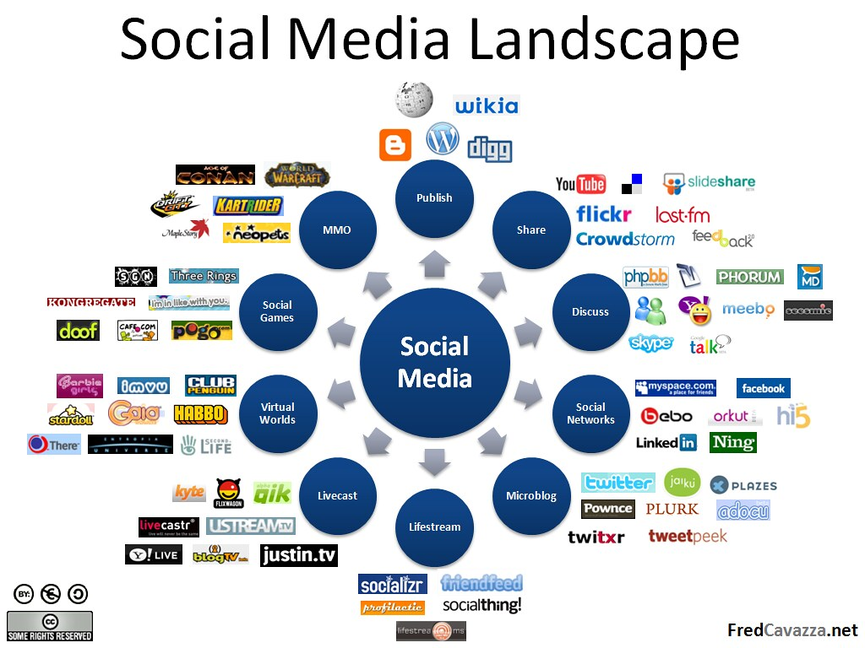
In class exercise developing a Social media strategy for ANU
In this exercise, you’ll develop a social media strategy for ANU. Recall that you are working in a competitive industry, and you already have some information about the business of ANU.
Go into more detail and identify the following (you can use the table on the following slide):
  Customer segment
  Value to ANU
  Preferred channels
  Content – type, frequency, etc.
  Measurement method
Describe a social media strategy that will help the ANU establish a social media presence.
Work in groups and be prepared to share your work with the class.
This Photo by Unknown Author is licensed under CC BY-SA-NC

Slide 7
ANU Social media strategy
Customer Segment | ANU Value | Channel(s) | Content | Measurement method

Slide 8

Questions?

